Slide 1
Integration Applications
First Moments, Center of Gravity, Centroid

Slide 2
Definitions
Center of Gravity: point in a body at which all the body’s mass could be concentrated without altering the effect that earth’s gravity has on the body.
Centroid: the equivalent to center of gravity for an area (since an area has no mass).
First Moments:
Moment of an area = area × distance to centroid
Moment of a volume = volume × distance to center of gravity
Moment of a mass = mass × distance to center of gravity

Slide 3
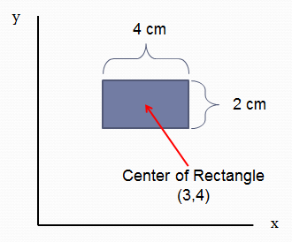
First Moment of Area
Moment about x-axis, Mx:
Mx = (Area)(Distance from x-axis to Center)
Mx = (8 cm² )(4 cm) = 32 cm³
Moment about y-axis, My:
My = (Area)(Distance from y-axis to Center)
My = (8 cm² )(3 cm) = 24 cm³

Slide 4
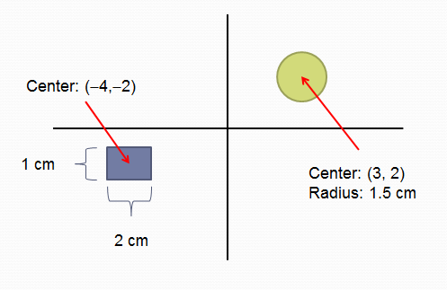
First Moment of Area
Mx = (Area)(Distance from x-axis to Center)
My = (Area)(Distance from y-axis to Center)
Rectangle:
Mx = (2 cm² )(−2 cm) = −4 cm³
My = (2 cm² )(−4 cm) = −8 cm³
Circle:
Mx = (2.25π cm² )(2 cm) = 14.1 cm³
My = (2.25π cm² )(3 cm) = 21.2 cm³

Slide 5
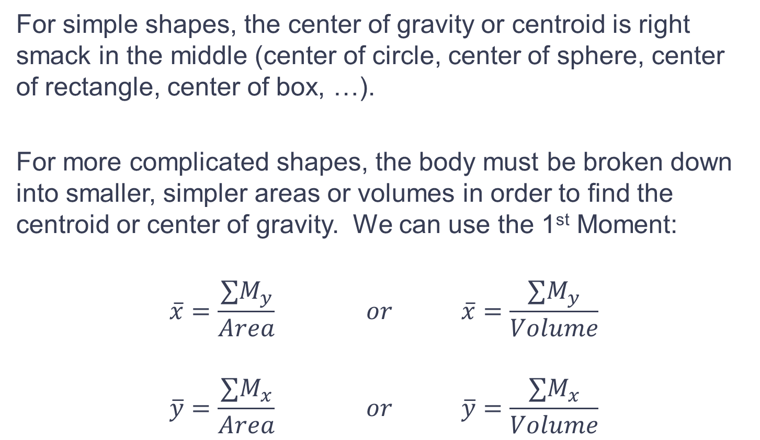
Center of Gravity, Centroid
For simple shapes, the center of gravity or centroid is right smack in the middle (center of circle, center of sphere, center of rectangle, center of box, …).
For more complicated shapes, the body must be broken down into smaller, simpler areas or volumes in order to find the centroid or center of gravity. We can use the 1st Moment:
$$\overline{x}=\frac{{∑M}_{y}}{Area} or \overline{x}=\frac{∑M_{y}}{Volume}$$
$$\overline{y}=\frac{{∑M}_{x}}{Area} or \overline{y}=\frac{∑M_{x}}{Volume}$$

Slide 6


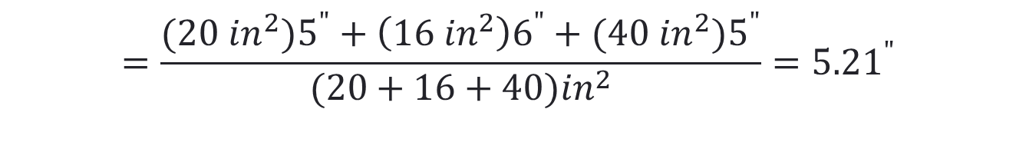


Example 1: Find Centroid
4”
4”
2”
Set up a coordinate system and find the center of each section. Then find the 1st Moment for each Section
l (5,8)
4”
l
(6,4)
4”
1st Moment about y-axis:
Bottom Block:
Middle Block:
Top Block:
l (5,1)
2”
(0,0)
$$M_{y}=\left(20 in^{2}\right)\left(5in\right)$$
$$M_{y}=\left(16 in^{2}\right)\left(6 in\right)$$
$$M_{y}=(40 in^{2})(5 in)$$
$$=\frac{(20 in^{2})5^{"}+\left(16 {in}^{2}\right)6^{"}+(40 in^{2})5^{"}}{(20+16+40){in}^{2}}={5.21}^{"}$$
$$\overline{x}=\frac{\sum{M_{y}}}{A}$$

Slide 7


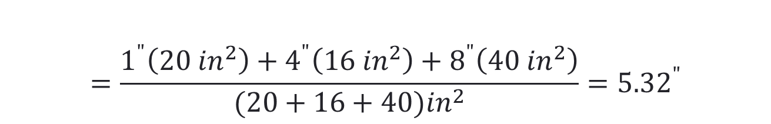


Example 1
4”
4”
2”
l (5,8)
4”
1st Moment about x-axis:
Bottom Block:
Middle Block:
Top Block:
4”
$$M_{x}=\left(20 in^{2}\right)\left(1 in\right)$$
l
(6,4)
$$M_{x}=\left(16 in^{2}\right)\left(4 in\right)$$
l (5,1)
2”
$$M_{x}=(40 in^{2})(8 in)$$
(0,0)
$$=\frac{1^{"}\left(20 {in}^{2}\right)+4^{"}\left(16 {in}^{2}\right)+8^{"}\left(40 {in}^{2}\right)}{(20+16+40){in}^{2}}={5.32}^{"}$$
$$\overline{y}=\frac{\sum{M_{x}}}{A}$$
Another Way to View This: The center of each section simply gets weighted by that section’s percentage of the total area.

Slide 8


Example 1
4”
4”
2”
l (5,8)
4”
$$\overline{x}={5.21}^{"}$$
l
(6,4)
4”
$$\overline{y}={5.32}^{"}$$
l (5,1)
2”
(0,0)
Does the answer seem reasonable?

Slide 9
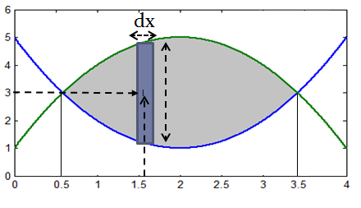

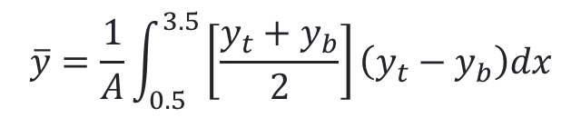
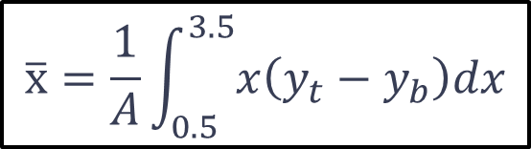

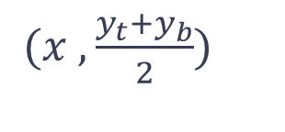
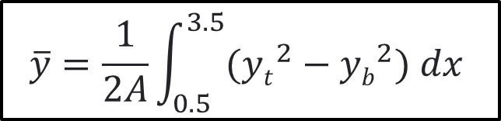
Center of Gravity, Centroid
y_{t}: Top Curve
y_{b}: Bottom Curve
$$y_{t}−y_{b}$$
$$\overline{x}=\frac{1}{A}\int_{0.5}^{3.5}{x\left(y_{t}−y_{b}\right)dx}$$
Coordinates of Center of Rectangle:
$$\overline{y}=\frac{1}{A}\int_{0.5}^{3.5}{\left[\frac{y_{t}+y_{b}}{2}\right]\left(y_{t}−y_{b}\right)dx}$$
$(x ,\frac{y_{t}+y_{b}}{2})$
Area of Rectangle:
$$\overline{y}=\frac{1}{2A}\int_{0.5}^{3.5}{({yt}^{2}−{yb}^{2}) dx }$$
$$\left(y_{t}−y_{b}\right)dx$$

Slide 10
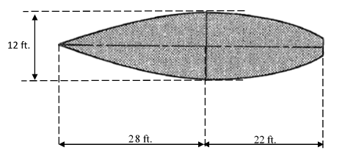
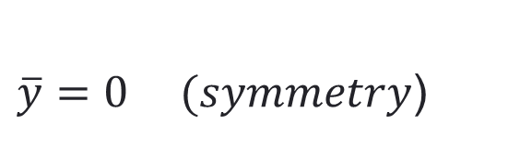
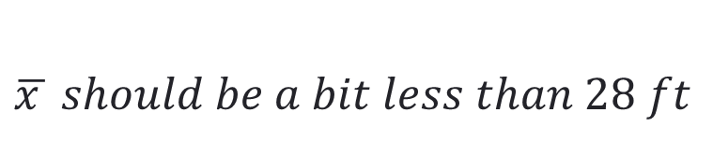


Example 2
Find the centroid of the deck of the ship with respect to the origin indicated. Assume the curves are parabolic.
$$\overline{y}=?$$
(0,0)
$\overline{y}=0 (symmetry$)
$$\overline{x}=?$$
$$\overline{x } should be a bit less than 28 ft$$

Slide 11
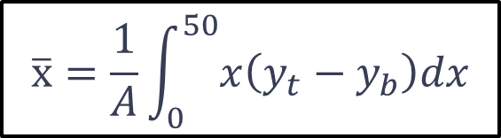
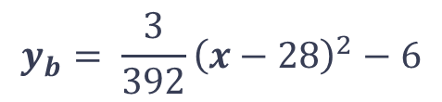
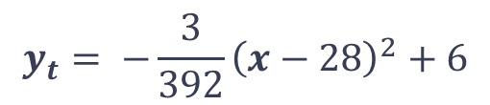
Example 2
Find the centroid of the deck of the ship with respect to the origin indicated.
$$\overline{x}=\frac{1}{A}\int_{0}^{50}{x\left(y_{t}−y_{b}\right)dx}$$
(0,0)
Equations for parabolic curves:
$$y_{t}= −\frac{3}{392}{\left(x−28\right)}^{2}+6$$
$$y_{b}= \frac{3}{392}{\left(x−28\right)}^{2}−6$$

Slide 12
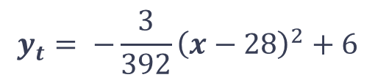
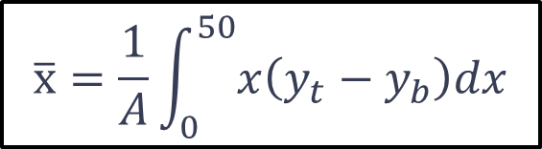
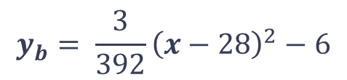
Example 2
$$y_{t}= −\frac{3}{392}{\left(x−28\right)}^{2}+6$$
$$\overline{x}=\frac{1}{A}\int_{0}^{50}{x\left(y_{t}−y_{b}\right)dx}$$
$$y_{b}= \frac{3}{392}{\left(x−28\right)}^{2}−6$$
>> yt = sym('-3/392*(x-28)^2+6');
>> yb = sym('3/392*(x-28)^2-6');
>> Area = int(yt-yb,'x',0,50)
Area = 21250/49
>> A = double(Area)
A = 433.6735 ft²

Slide 13

Example 2
$$\overline{x}=\frac{1}{A}\int_{0}^{50}{x\left(y_{t}−y_{b}\right)dx}$$
>> syms x; % MUST DEFINE x AS A SYMBOLIC!!!
>> xbar = 1/A*int(x*(yt-yb),'x',0,50)
xbar = 925/34
>> xbar = double(xbar)
xbar = 27.2059
$\overline{x}=27.2059 ft$

Slide 14
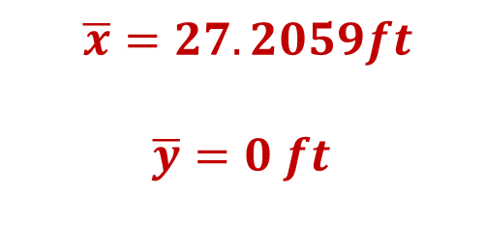
Example 2
$\overline{x}=27.2059ft$
$$\overline{y}=0 ft$$
(0,0)

Slide 15
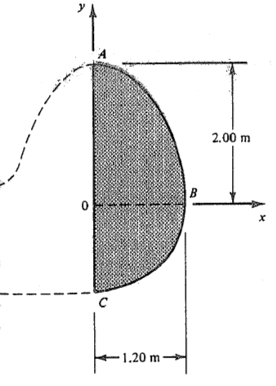
Example 3
The airplane rudder pictured below consists of one quadrant of an ellipse and one quadrant of a circle. Find the coordinates of the centroid.
What would be a reasonable guess for xbar and ybar?
Origin

Slide 16
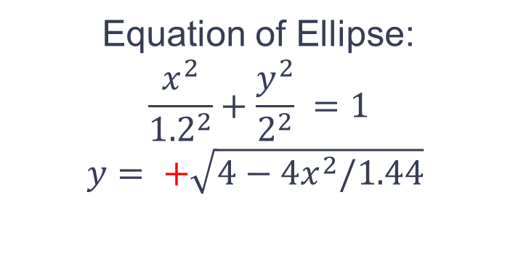
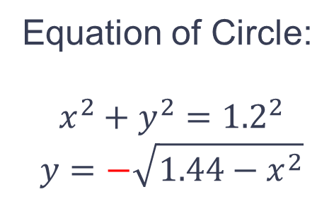
Example 3
The airplane rudder pictured below consists of one quadrant of an ellipse and one quadrant of a circle. Find the coordinates of the centroid.
Equation of Ellipse:
$$\frac{x^{2}}{{1.2}^{2}}+\frac{y^{2}}{2^{2}} =1$$
$$y= +\sqrt{4−4x^{2}/1.44}$$
Equation of Circle:
$$x^{2}+y^{2}={1.2}^{2}$$
$$y=−\sqrt{1.44−x^{2}}$$
Origin

Slide 17
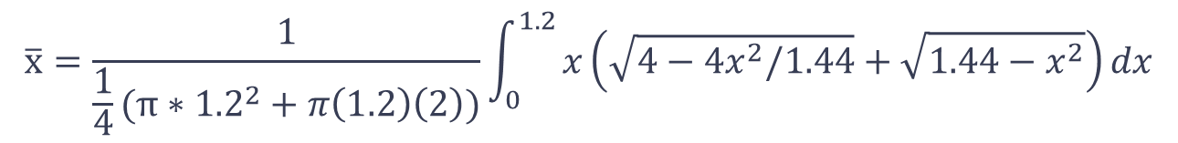
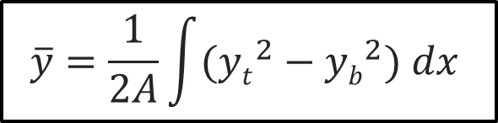
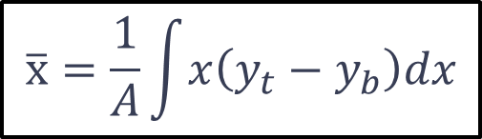
Example 3
$$\overline{x}=\frac{1}{A}\int{x\left(y_{t}−y_{b}\right)dx}$$
$$\overline{y}=\frac{1}{2A}\int{({yt}^{2}−{yb}^{2}) dx }$$
Area of quarter circle: $\frac{1}{4}πr^{2} Area of quarter ellipse: \frac{1}{4} π(a)(b)$
$$\overline{x}=\frac{1}{\frac{1}{4}(π∗{1.2}^{2}+π\left(1.2\right)\left(2\right))}\int_{0}^{1.2}{x\left(\sqrt{4−4x^{2}/1.44}+\sqrt{1.44−x^{2}}\right)dx}$$
$$\overline{y}=\frac{1}{2×\frac{1}{4}(π{∗1.2}^{2}+π\left(1.2\right)\left(2\right))}\int_{0}^{1.2}{\left[\left(4 −\frac{4x^{2}}{1.44}\right)−(1.44 −x^{2})\right]dx}$$
This is no fun to do by hand!

Slide 18
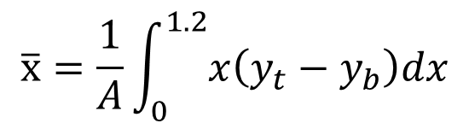

Example 3
$$\overline{x}=\frac{1}{A}\int_{0}^{1.2}{x\left(y_{t}−y_{b}\right)dx}$$
>> yt = sym('sqrt(4-4*x^2/1.44)');
>> yb = sym('-sqrt(1.44-x^2)');
>> A = 1/4*(pi*1.2^2 + pi *1.2*2);
Or
>> A = double(int(yt-yb,'x',0,1.2))
A = 3.0159
>> syms x % Don’t forget this!!!!
>> xbar = 1/A*int(x*(yt-yb),'x',0,1.2);
>> xbar = double(xbar)
xbar = 0.5093
$\overline{x}=0.5093 m$

Slide 19
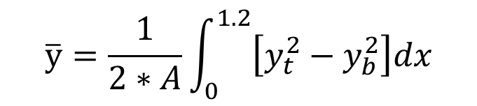
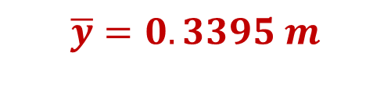
Example 3
$$\overline{y}=\frac{1}{2∗A}\int_{0}^{1.2}{\left[y_{t}^{2}−y_{b}^{2}\right]dx}$$
>> ybar = 1/(2*A)*int(yt^2-yb^2,'x',0,1.2);
>> ybar = double(ybar)
$$\overline{y}=0.3395 m$$

Slide 20
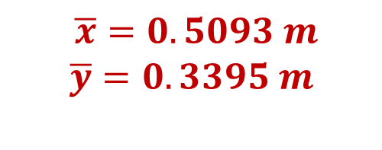
Example 3
$\overline{x}=0.5093 m$
$$\overline{y}=0.3395 m$$
Origin
Does the answer seem reasonable?

